Slide 1
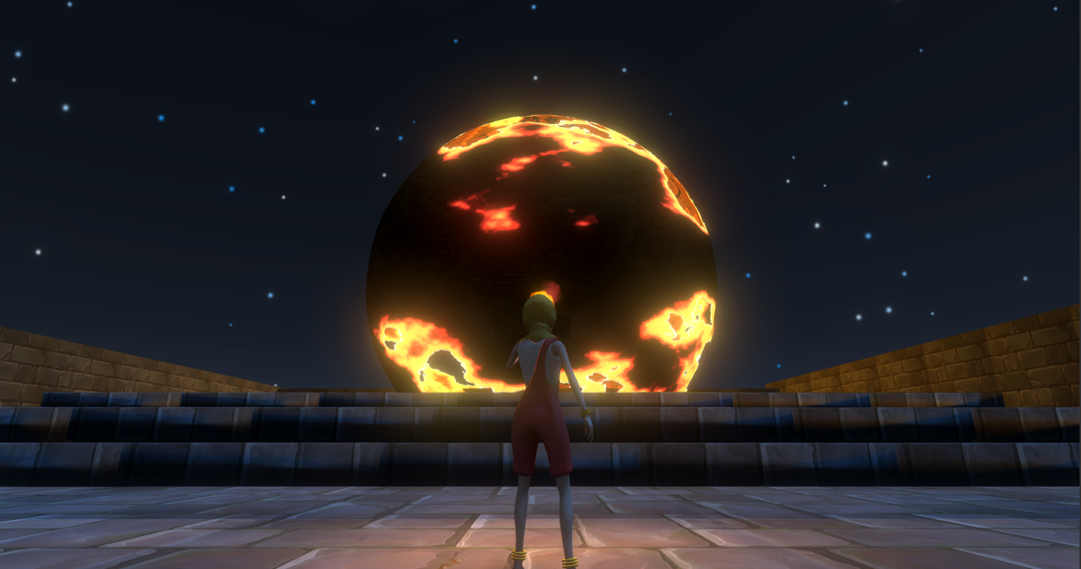
Rayha’s Poem
By Gordon Lee and Mostafa Haque

Slide 2

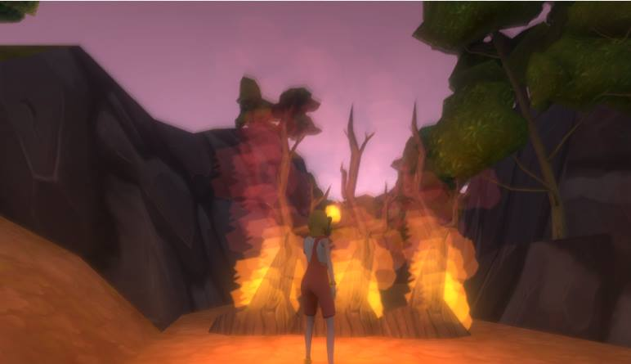
What is it
A third person narrative platformer about a little girl running away to a mythical kingdom to escape child marriage.
Notes:
A third person narrative platformer about a little girl running away to a mythical kingdom to escape child marriage.

Slide 3
Themes
Child marriage
South Asian fairytales
Fairyland as a metaphor

Slide 4
Iterative Process
Multiplayer prototype
Artful Dodgers
Enuma Elish
The Bride (Singleplayer)
Rayha’s Poem

Slide 5
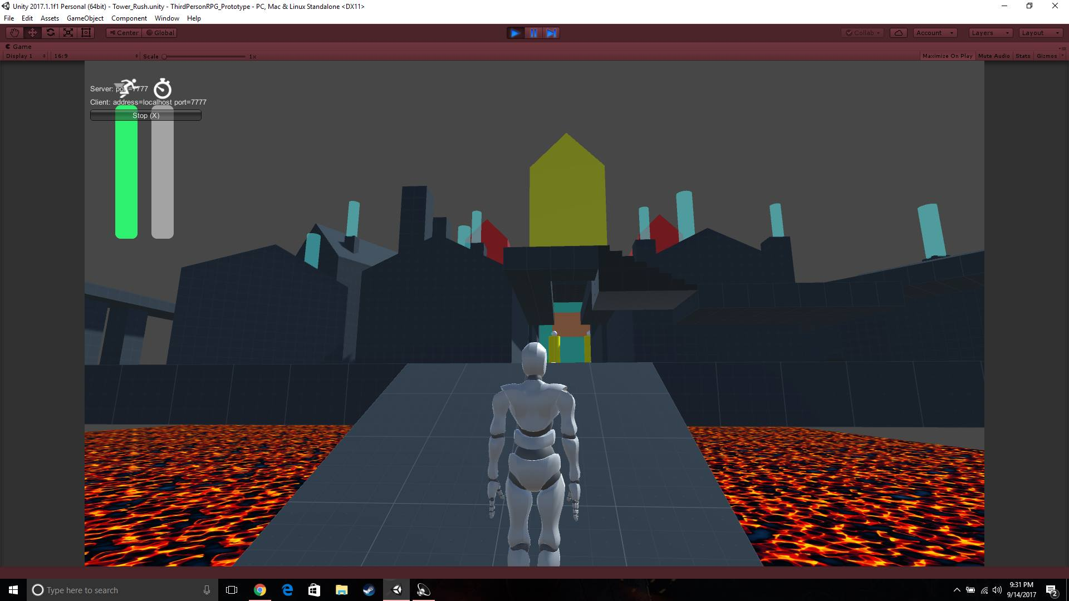
Multiplayer prototype (Gordon)

Slide 6
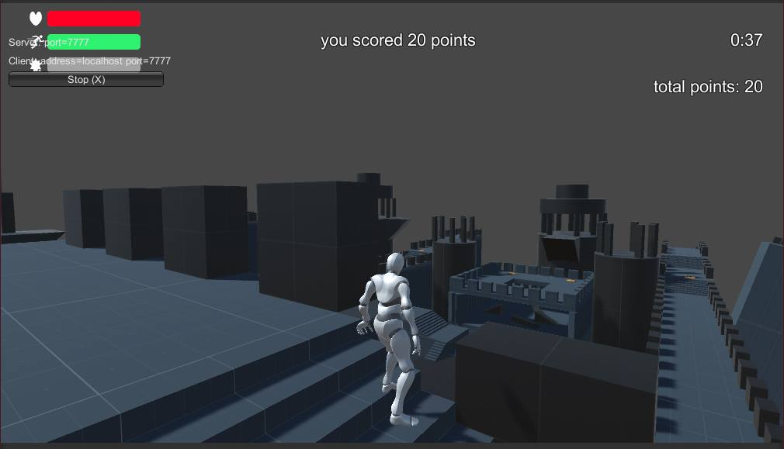
Multiplayer prototype (Gordon)

Slide 7
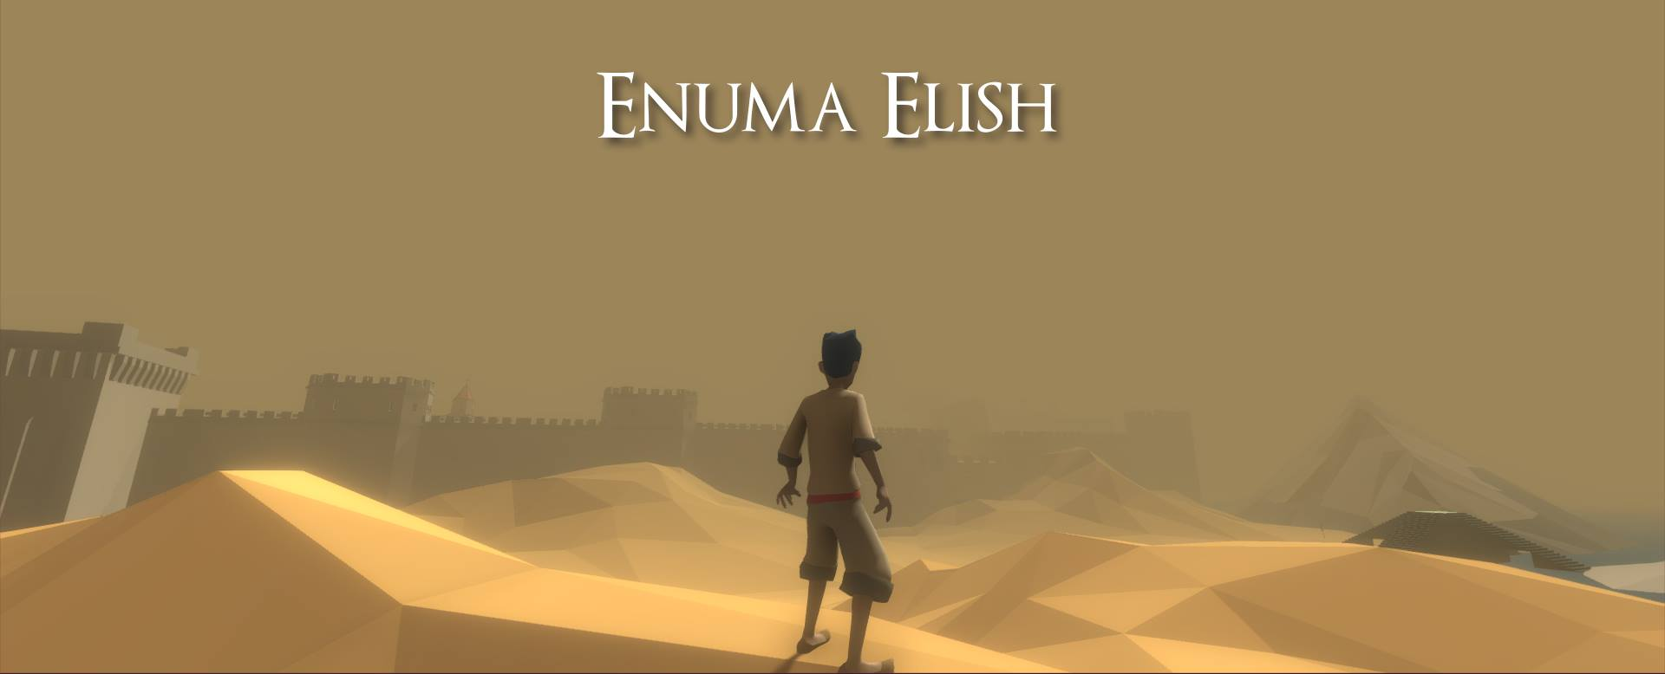
Enuma Elish (Mostafa)

Slide 8
Single player pivot
Network issues
Lack of focused design
Not a story we wanted to tell
Notes:
We needed a story – a narrative

Slide 9
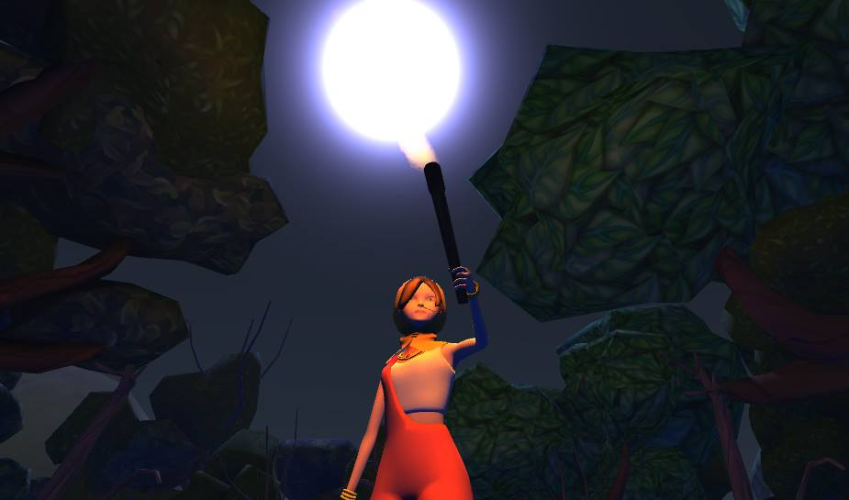
The Bride (Single player prototype)
Notes:
I wanted to talk about this issue because child marriage laws in Bangladesh changed

Slide 10
How we the Story?
The story structure.
Decide when and where the story happened.
Who is the protagonist in the story.
Add fun plots which can be made to playable games.

Slide 11
Visualize in 3D - Design the World
Terrain
Forest
Ruined castle

Slide 12
Visualize in 3D - Design the Character
As the game development
As the story development

Slide 13

Final Product – Rayha’s Poem

